Slide 1
Object Oriented Principles
August 28, 2016

Slide 2
What if we do not follow OOP principles?
Major Elements :
if a model does not have any one of these elements, it ceases to be object oriented
Abstraction
Encapsulation
Modularity
Hierarchy
Minor Elements :
these elements are useful, but not indispensable part of the object mode
Typing
Concurrency
Persistence

Slide 3
Objectives
Learn what happens if we don’t follow the object oriented principles
By the end of this Presentation, you will have a fair idea about Object oriented principles.
How we can apply these principles in different situations.
What are benefits of using object oriented principles.

Slide 4

What if we do not follow OOP Principles
OO Principles are helpful in making a good design and if we do not follow then we end up with a bad design for our application which is-
Rigid
Hard to change/modify the application because every change effects too many parts.
Fragile
When you make a change , unexpected parts of the system break.
Immobile
Hard to use another application because it can not disentangled from the current application.

Slide 5
Major Elements

Slide 6
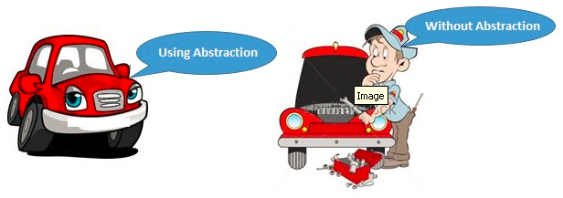
Abstraction
Abstraction means to focus on the essential features of an element or object, ignoring its extraneous or accidental properties.
Hiding necessary data from the users and making the application as user friendly is called abstraction.
For example- Brakes in Car. User knows about the brake functionality that it will stop the car. But he do not need to know about the internals of brake functioning.

Slide 7
Abstraction (Contd..)
When to use abstraction
when you know something needs to be there but not sure how exactly it should look like.
Ex- when I am creating a class called Vehicle, I know there should be methods like start() and stop() but don't know how that start and stop method should work, because every vehicle can have different start and stop mechanism.
How to achieve Abstraction in JAVA?
Abstract class (0 to 100%)
Interface (Achieve 100% abstraction)

Slide 8
Abstract Classes
Some classes are incomplete and should not be instantiated.
Animal, SingleRoamer and GroupRoamer.
Animal animal = new Animal(); - it’s like which Animal?
These are called Abstract classes.
The classes that can be instantiated are called Concrete classes.
For ex. Lion, Cat etc.
An abstract class has one or more abstract functions. A concrete class can not have any abstract method.
An abstract class has no purpose unless it is extended.

Slide 9
Abstract Methods
Some methods in the class don’t show a specific behavior. For ex.
roam, speak and eat methods in Animal class.
These are called Abstract methods as they don’t have any body.
Implementing an abstract method is like overriding the method.
You must implement all abstract methods in concrete class.

Slide 10
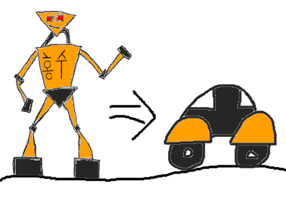
Casting
Casting
Changing the type of one class to other compatible type.
Casting an object reference back to its original type. For ex.
instanceOf operator – to make sure that object is of type Lion.
Object obj = new Lion();
Lion lion = (Lion) obj;
lion.speak();
If ( obj instanceOf Lion) {
Lion lion = (Lion) obj;
}
lion.speak();

Slide 11
Exercise – Financial Instrument
Create the classes depicted in the adjoining diagram. Each concrete instrument type has the different logic to price the security.
Create a portfolio of financial instruments and then calculate the total price that needs to be paid to build the portfolio.
Bonds accrue interests while stocks don’t. Identify the Bonds in the list of financial instruments and then calculate the total interest paid by the bonds in the portfolio.
Demonstrate “FinancialInstrumentsTest” class.

Slide 12

Wait a minute. I have few questions.
Can I instantiate a class if only a method in the class is abstract?
What is the advantage of a class if all of its methods are abstract?
What if I like to use both the methods defined in base class and its overridden behavior in the child class?
Can we extend any class?
Notes:
No. It is mandatory to make the class abstract if one of the method is abstract.
It provides the contract that all the child classes need to adhere to.
Use super.<method name>() from the child class method.
As long as the class is not final and access modifiers are correct, you can extend the class.

Slide 13

Interfaces
The public methods and attributes of a class are considered interfaces.
Interfaces define how the users of the class interact with the class.
There could be multiple ways of defining the interfaces of the class – interface, abstract class, public methods.
Implementation details like algorithm to sort employees, calculate square root of a number should be hidden from the other objects.
Notes:
Picture:
The electrical socket is an interface to all electrical appliances. They don’t need to know how electricity is generated – by nuclear power plant or by water. As long as the electrical appliances meet the specifications of interfaces, they get the required electricity for its operation.

Slide 14
Interface Format
Format for specifying the interface
Interface <name of interface>
{
constants
methods to be implemented
}
Format for realizing / implementing the interface
class <name of class> implements <name of interface>
{
data fields
methods actually implemented
}

Slide 15
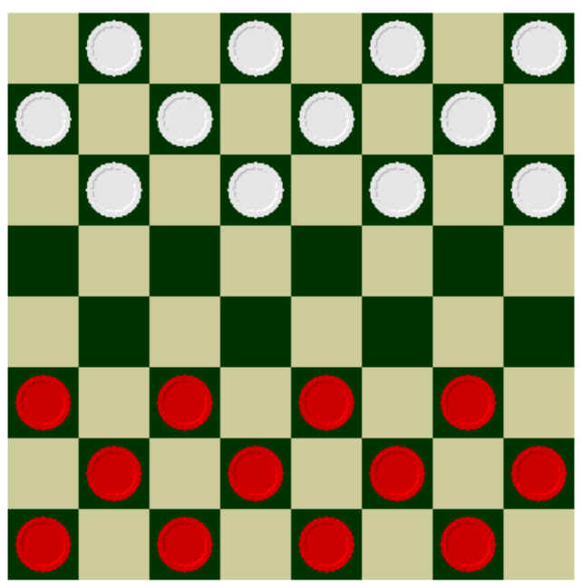
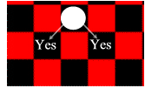

Interfaces: A Checkers Example
Regular rules
Basic board
Variant rules

Slide 16
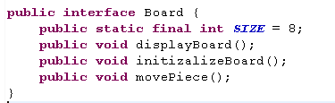
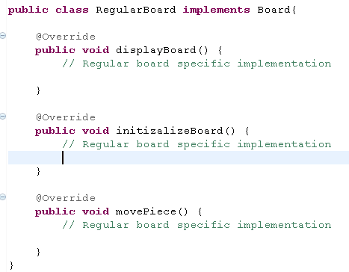
Solution
Interface Board-
Class RegularBoard

Slide 17
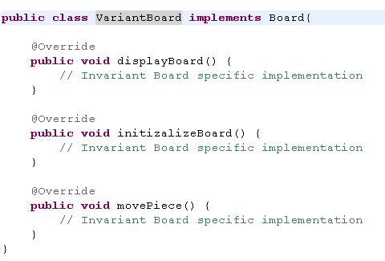
VariantBoard class

Slide 18
Implementing Multiple Interfaces
Class <class name> implements <interface 1>, <interface 2>, <interface 3>{
}
Interface1
Interface2
Interface3
Class

Slide 19
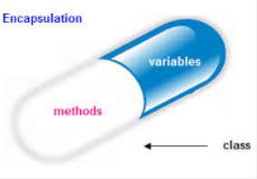
Encapsulation And Data (Information) Hiding
A mechanism of wrapping the data (variables) and code acting on the data (methods) together as a single unit.
In encapsulation the variables of a class will be hidden from other classes, and can be accessed only through the methods of their current class, therefore it is also known as data hiding.
To achieve encapsulation in Java
Declare the variables of a class as private.
Provide public setter and getter methods to modify and view the variables values.
Benefits of Encapsulation:
The fields of a class can be made read-only or write-only.
A class can have total control over what is stored in its fields.
The users of a class do not know how the class stores its data. A class can change the data type of a field and users of the class do not need to change any of their code.

Slide 20

Data Hiding
An object should not disclose all its attributes and behaviors.
It should reveal only the required methods which the other object require to interact with.
These methods which need to be exposed to other objects define the interface of the class.
For ex. An object to sort a list of employees should only expose the method which accepts list of employees as parameter and the algorithm to sort the employees should be hidden from the other object.

Slide 21
Encapsulation is not Information Hiding
Encapsulation is just the container we need to place our similar items like fields and methods, While Data Hiding is protecting your data from outside world (Clients and Consumers)
Data Hiding is not possible without Encapsulation. You can't hide your data without putting it in some form of container. But yes Encapsulation is possible without hiding your data. Put all things public and you can the see the affect.
Keeping instance variable and getters/setters methods as public is still Encapsulation but this way we are not achieving Data Hiding.

Slide 22

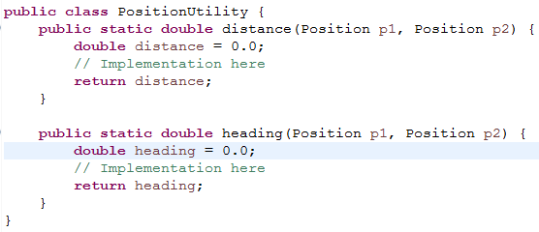
Encapsulation is not Information Hiding (Contd..)
Consider a class Position-
At present Position is nothing but a bag of data.
To utilize those objects of Position, class PositionUtility contains methods for calculating the distance and heading.
Are Position and PositionUtility are not properly Object Oriented though JAVA is OO language ??? – NO
Here position is simple data structure and PositionUtility is repository of mehtods.

Slide 23
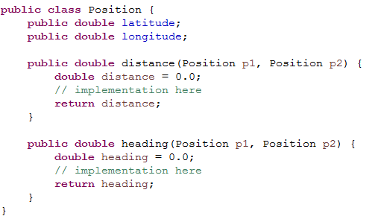
Encapsulation is not Information Hiding (Contd..)
Bundle the data with methods in Position class:
This bundling is called Encapsulation.
As of now it do not provide any data protection or security.

Slide 24
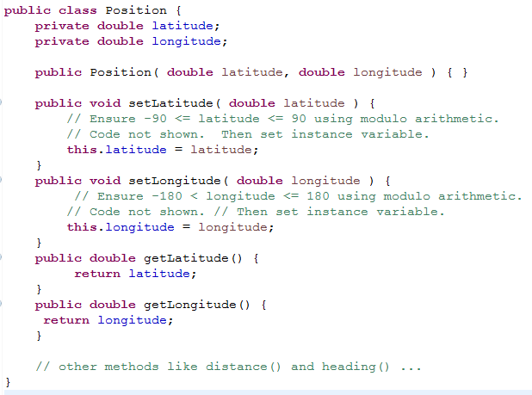
Encapsulation is not Information Hiding (Contd..)
Restrict the acceptable values of latitude and longitude through public setters.
Here Data (Information) hiding is implemented through Encapsulation..

Slide 25
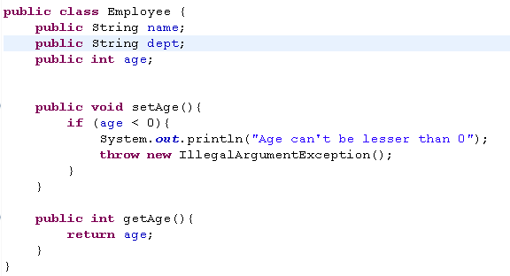
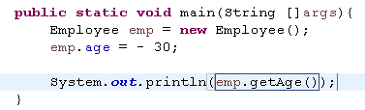
Why Data Hiding is Important
Let’s look at below example
Now consider below main method:

Slide 26

Why Data Hiding is Important (Contd..)
In main method below line is offending -
emp.age = - 30;
We just have an employee with negative age??
To avoid such errors, Keep the information (variables) hidden (private) from outer world and expose setter behaviors where a level of control can be implemented.
Like we have the public setAge() method where in we are throwing IllegalArgumentException in case someone tries to set illegal value to age.

Slide 27

Modularity
The process of decomposing a problem (program) into a set of modules so as to reduce the overall complexity of the problem.
Decomposition should be a set of cohesive and loosely coupled modules.
Modularity is intrinsically linked with encapsulation. Can be visualized as a way of mapping encapsulated abstractions into real, physical modules having high cohesion and low coupling.

Slide 28
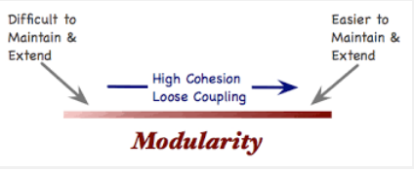
Benefits
Scalable Development.
Testable Code Unit.
Build Robust System.
Easier Modification & Maintenance.
Functionally Scalable.
Project Jigsaw: Modularity in JAVA-9
Go through below link for more information on Jigsaw:
https://vox.publicis.sapient.com/docs/DOC-136773

Slide 29
Benchmarks of Modularity
While making your code more modular, ask yourself the below questions:
How many times are you rewriting similar code for a particular task?
How much code do you have to refactor your code in case you change something?
Are the files smaller and easier to navigate through?
Are the application modules performing adequately and independently as and when required?
How less disastrous is your code? Does all hell break lose when you delete just one function or variable?
How near is the code to natural language usage (i.e. modules and their subcomponents represent more real world objects without giving much concern to net source file size).

Slide 30

Hierarchy
A system is made up of interrelated subsystems, which can have their own subsystems and so on until the smallest level components are reached
Hierarchy is the ranking or ordering of abstraction.
Hierarchy allows code reusability.

Slide 31
Types of Hierarchy in OOA
IS–A hierarchy
Hierarchy in Inheritance relationship.
Sub Classes are derived from Super Class.
For Ex.- Rose can be derived from Flower and we can say Rose “is – a” Flower.
PART-OF hierarchy
Defines the hierarchy relationship in composition/aggregation.
One class is composed of another class.
For Ex.- Flower is composed of sepals, petals, stamens etc. and we can say Petal is “part-of” Flower.

Slide 32

Inheritance (Is-A Hierarchy)
Inheritance is a way to form new classes using classes that have already been defined.
Inheritance is employed to help reuse existing code with little or no modification
Is-A Relationship.
For ex.
CivilEngineer is an Enginner.
Manager is an Employee.
Lion is an Animal.
MountainBike is a Bicycle.
Notes:
http://www.learn-java-tutorial.com/Java-Inheritance.cfm

Slide 33

Benefits and Usage
Inheritance Benefits
Avoid duplication of code.
Classes inherited from the same base class can be used interchangeably.
Syntax:
FamilyDoctor extends Doctor
Surgeon extends Doctor
// FamilyDoctor extends Doctor
public class FamilyDoctor extends Doctor {
}
// Surgeon extends Doctor
public class Surgeon extends Doctor {
}
Notes:
http://www.codestyle.org/java/faq-Inheritance.shtml#inheritancebenefits
If the return type of a method is Doctor, then the application can be adapted to return Surgeon as well as FamilyDoctor.

Slide 34
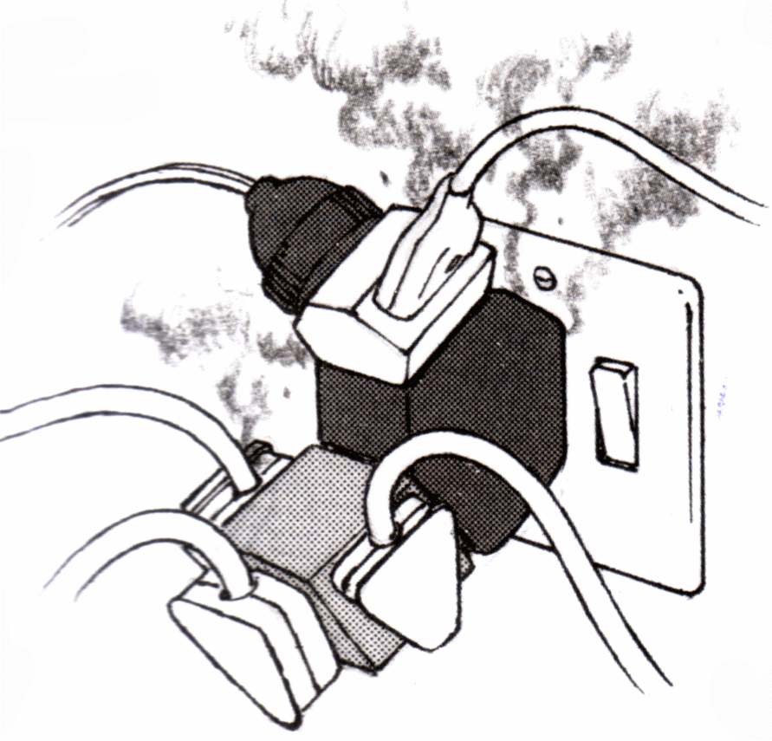

Overloading and Overriding
Overloading
Writing two or more methods with the same name in the same class.
The method parameters are different.
The methods can’t be overloaded just by changing the return type.
Overriding
A method with the same name and parameters present in base and child class.
The child class method is overriding the base class method.
Overriding changes the behavior of the method in the child class.

Slide 35

Exercise – Employee Bonus Calculator
The company is planning to role out bonuses to employees, there are 2 kinds of employees –
1) Regular
2) Contractors
And there are different criteria for bonus pay out for both kind of employees.
- Regular employees get bonus as 10-15% of their salary
- Contractors get bonus as 5,000 flat.
Design a program which accepts employees as input and prints the bonus amount for the employee.
Understand the following
Inheritance, Overriding
Notes:
(HINT: Using the base employee class - 1) add a method in the base employee class - calcBonus() which returns the bonus amount. 2) create 2 classes which extend employee class - RegularEmployee, Contractor. Make both classes overload the calcBonus() method and write separate logic for both types of employees.)

Slide 36

Exercise – Tax Test
Tax in a country depends on three factors – Gross Income, country and dependents.
The gross income and state are mandatory input parameters while the third one is optional. The system assumes the dependents to be 1 if none is specified.
Create a Tax class having the above three member variables. The system then calls a method to calculate the tax.
Demonstrate “TaxTest” example.
Understand the following
Overloading the constructors
Calling one constructor from other

Slide 37
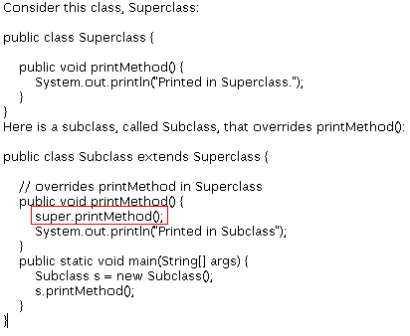
Super keyword
If your method overrides one of its superclass's methods, you can invoke the overridden method through the use of the keyword super
You can also use super to refer to a hidden field

Slide 38
Inheritance w.r.t constructors
All the constructors in an object’s inheritance run when you make a new object.
Super class constructor is called by calling “super()” inside the child class constructor. Call to super() must be the first statement in each constructor.
Same class overloaded constructors can be called by calling “this()” inside the constructor. Call to this() must be the first statement in the constructor.
A constructor can either have “super()” or “this()”.
public class Elephant extends Animal {
int size;
public Elephant() {
this(100);
}
public Elephant(int size) {
this.size = size;
}
}

Slide 39

Exercise – FringeTaxTest
Assume the logic to calculate Fringe Tax is different from the remaining.
There are few countries that implement fringe tax. Write a FringeTax class that extends Tax and takes an additional parameter in constructor – fringeBenefit.
It then calculates the total tax.
Demonstrate “FringeTaxTest” example.
Understand the following
Calling base class constructor

Slide 40

Composition (PART-OF Hierarchy)
Few classes don’t support IS-A relationship like Basket and Fruit.
Explains Has-A or USES-A relationship For ex. Building has washroom, Professor teaches students.
Shows whole/part relationship.
Smaller objects combine to make a big object.

Slide 41
Relations Between Classes
Composition (“has-a”)
Association (“knows-a”)
Inheritance (“is-a”)
The Final Modifier (Inheritance):
Methods preceded by the final modifier cannot be overridden
e.g., public final void displayTwo ()
Classes preceded by the final modifier cannot be extended
e.g., final class ParentFoo

Slide 42


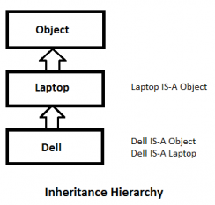

When to use inheritance and aggregation
If the new class is more or less as the original class. Use inheritance. The new class is now a subclass of the original class.
If the new class must have the original class. Use aggregation. The new class has now the original class as a member.
Inheritance can be implemented with extends (in case of class) and implements(in case of interface) keywords.
Example: IS-A relation: Dell IS-A Laptop
Any class that passes the IS-A relationship with another class, use inheritance.

Slide 43

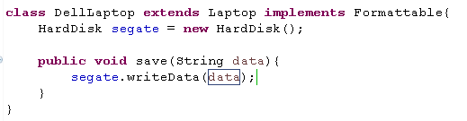
When to use inheritance and aggregation (Contd..)
Any Class passes HAS-A relationship for another object, use aggregation or composition.
Ex: Dell IS-A Laptop and it HAS-A Hard Disk.
See how Dell laptop has access to HardDisk’s writeData() method.

Slide 44
Minor Elements

Slide 45
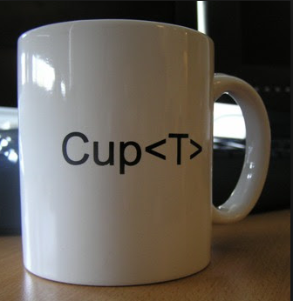
Typing
Type is characterization of set of elements.
In OOP, Class is visualized as a type having properties distinct from other types.
Object is an instance of single class or type.
Two Types of Typing:
Strong Typing
Weak Typing

Slide 46
Strong Typing
A programming language is strongly typed if:
type errors are always detected
There is strict enforcement of type rules with no exceptions.
All types are known at compile time, i.e. are statically bound.
With variables that can store values of more than one type, incorrect type usage can be detected at run-time.
Strong typing catches more errors at compile time than weak typing, resulting in fewer run-time exceptions.
Example of Strongly Typed language: Ada, Java, Haskell etc. Sometime C/C++ are sometimes described as strongly typed but are perhaps better described as weakly typed because parameter type checking can be avoided and unions are not type checked.

Slide 47
Weak Typing and Coercion
Operation is checked only at the time of execution.
Doing a lot implicit (automatic) coercion weakens the type system.
Most languages do it to some degree
X = 1
Y = 2.0
X + Y
But overuse can cause problem
X = 1
Y = “2”
X + Y
Many languages will produce the float 3.0 for X + Y
X + Y is 3 in Visual Basic and 12 in Java script

Slide 48
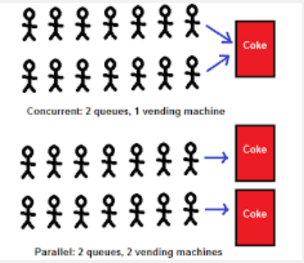
Concurrency
Allows performing multiple tasks for processes simultaneously.
Most systems have multiple threads- some active, some waiting for CPU, some suspended and some terminated.
Multiple CPU inherently permit concurrent threads of control.
In Object- Oriented environment, there are active and inactive objects.
The active objects have independent threads of control that can execute concurrently with threads of other objects.

Slide 49
Concurrency Models I
Processes versus Threads
Threads
Fibres
Process
thread library
Operating System

Slide 50
Concurrency Models II
Java supports threads
Threads execute within a single JVM
Native threads map a single Java thread to an OS thread
Green threads adopt the thread library approach (threads are invisible to the OS)
On a multiprocessor system, native threads are required to get true parallelism (but this is still implementation dependent)

Slide 51
Concurrency Models III
Communication and Synchronization
approaches broadly classified as shared-variable or message passing
many different models, a popular one is a monitor
a monitor can be considered as an object where each of its operation executes in mutual exclusion
lock
procedural interface
encapsulated state

Slide 52

Persistence
The property by which an object continues to exist even after its creator ceases to exist is known as persistence.
Persistence is the ability of an object to survive the lifetime of the OS process in which it resides
The lifespan of an object is typically the lifespan of the execution of the program that created it.
In files or databases, object’s lifespan is longer than the process creating the object.
Persistence is relevant for objects with an internal state.
The state needs to be retained between object deactivation and object activation.

Slide 53
How to achieve Persistence?
Should be transparent to application developer
Storing object state on persistent storage before de-activation
Upon activation, load object state from persistent storage
Persistent storage can be
File system
Relational Database
Object-Database
Flash-RAM
Java support other persistency mechanism
Serialization
Externalization
Both are technique to
Write composite objects into the byte stream
Load composite objects from a byte stream

Slide 54
Recap
Abstraction
Focus on the essential features of an element or object.
In java, abstraction is used by-
Abstract Classes
Interfaces
Abstract Class
Can’t be instantiated.
Keep the methods (with definition) which are common across sub classes under same hierarchy.
Can have one or more abstract methods (method without body).
Interface
Interfaces define how the users of the class interact with the class.
Have only abstract methods.
It’s is contract like if any class implement this interface, then that class must have those methods implemented which are exposed by the interface.

Slide 55
Recap
Encapsulation and Information Hiding
A mechanism of wrapping data and methods is called encapsulation.
To achieve encapsulation in Java
Declare the variables of a class as private.
Provide public setter and getter methods to modify and view the variables values.
Data Hiding
An object should not disclose all its attributes and behaviors.
Give you some control through which you can prevent some errors while setting the variables data.
Modularity
The process of decomposing a problem (program) into a set of modules so as to reduce the overall complexity of the problem.
Decomposition should be a set of cohesive and loosely coupled modules.
Make code more readable and understandable.

Slide 56
Recap
Hierarchy
Hierarchy is the ranking or ordering of abstraction.
Types
IS-A Hierarchy
Hierarchy in Inheritance relationship.
Sub Classes are derived from Super Class.
Part-Of Hierarchy
Defines the hierarchy relationship in composition/aggregation.
One class is composed of another class.
Overloading and Overriding.
Writing two or more methods with the same name in the same class or subclass with different argument list is called overloading.
Method parameters are different. It’s compile time binding.
A method with the same name and parameters present in base and child class is overloading.
It’s run time binding.

Slide 57
Recap
Composition
One object containing another object. Like Room Has-a Fan.
Aggregation and Composition
When inner object can’t stand alone without the outer object is called aggregation. Like Heart and Person.
When one object is passed to another object. And contained object can survive stand alone, like Steering of a Car.
Typing
Strong type
Strict enforcement of type rules.
All types are known at compile time.
Weak type
Type is checked at run time.

Slide 58
References
http://www.tutorialspoint.com/object_oriented_analysis_design/ooad_object_oriented_principles.htm

Slide 59
THANK YOU

